Slide 1

MASKED FACE RECOGNITION WITH SIAMESE NETWORK-BASED METRIC LEARNING By Kevin Rasikbhai Akbari
Student ID number: 990511
MSc Artificial Intelligence and Machine Learning

Slide 2
Overall Agenda
Motivation and Background
Research Questions
Literature Review
Problem Statement
Methodology
Results & Discussion
Conclusion and Future Works
Limitations of the Work

Slide 3
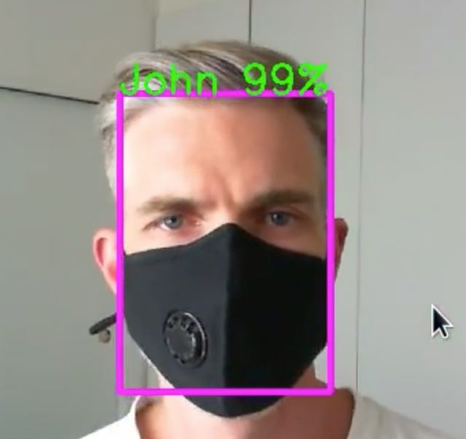
Motivation and Background
Face recognition is a non-trivial technology used abundantly these days
tasks like authentication, attendance systems, phone unlocking, finding the subject of interest from surveillance clips, etc.
People wear mask these days to avoid pollution, contagious diseases, deadly viruses, etc. and the same makes face recognition challenging
normal algorithms are ineffective for masked-face recognition (Mishra et al., 2021b)
Two broad approaches in existence
recovery of the masked part with generative models
discarding the mask-occluded part
These methods are computationally expensive, not so efficient

Slide 4
Motivation and Background
Attention mechanism may aid in focusing on important region and hence could lead to promising results
(Li et al., 2021) adopted a mix of discarding and attention mechanism to achieve high metric value in the task of masked face recognition.
Rather than considering as a classification problem, metric learning based approach could add more generalization
Unmasked face recognition is being tackled widely by metric learning methods

Slide 5

Problem Statement
Face recognition is being used for non-trivial tasks like authentication, attendance systems, phone unlocking, finding the subject of interest from surveillance clips, etc.
Occlusion caused due to objects like mask, scarf, cap, hat, etc. pose major challenge in identifying the subject
Occlusion due to face mask hides nose and mouth region, which are major discriminating features of the face
Human brain can intuitively focus on non-occluded region of the face while identifying the subject but the machines don’t have such natural tendency

Slide 6
Literature Review
CNN for Computer Vision
An experiment by Hubel and Wiesel change the way unstructured data is treated
CNN is being widely used for solving various computer vision tasks
Attention Mechanism in CNN
The aim of Attention in CNN is to bring focus of the model to important area
(Wang et al., 2017) proposed an architecture that contains attention modules which generate attention-aware features
Squeeze and Excitation network proposed by (Hu et al., 2017) does something similar to generate features
Convolutional Block Attention Module (CBAM) proposed by (Woo et al., 2018) is built on top of SE network by (Hu et al., 2017)
Likewise, (Li et al., 2020) gave similar mechanism to enhance the facial expression recognition

Slide 7
Literature Review
Metric Learning Approach for Face Recognition
Treating Face Recognition as classification task could raise the bulkiness of the model and hence Metric Learning is ideal choice
Metric Learning converts the higher dimensional input images to the lower dimensional embedding, while preserving the semantic distance
Siamese network proposed by (Chopra et al., 2005) and Triplet Network by (Hoffer and Ailon, 2015) are successful architectures
Model trained with metric learning along with task specific custom loss function could lead to good results

Slide 8
Literature Review
Existing Approach for Masked-Face Recognition
Recovery of Masked-part with Generative Models
Method: Employing generative models, remove the masked region and synthesize the occluded region while maintaining face structure, other details
Examples: (Ud Din et al., 2020), (Li et al., 2020)
Challenges: GAN-based models are computationally heavy, ineffective at recovering faces for the task of face recognition
Discarding the Mask-occluded part of the Face
Method: Discard the mask-occluded region and use the uncovered region
Examples: (Song et al., 2019), (Hariri, 2021)
Challenges: Image specific treatment needed based on occlusion level and hence cumbersome

Slide 9

Research Questions
1. Whether the attention mechanism effective in tackling the less important occluded region generated due to mask?
2. Is it possible to train a deep learning model for the masked face recognition task using Siamese architecture and custom loss function?

Slide 10
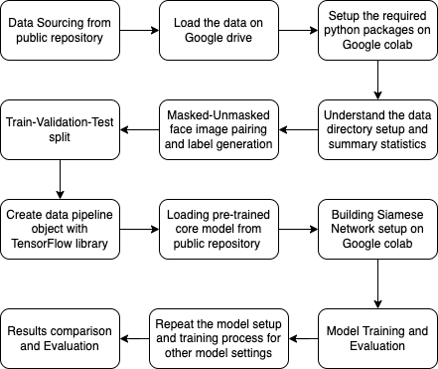
Methodology
Methodology workflow diagram depicting the actions taken to achieve the objective of the study

Slide 11
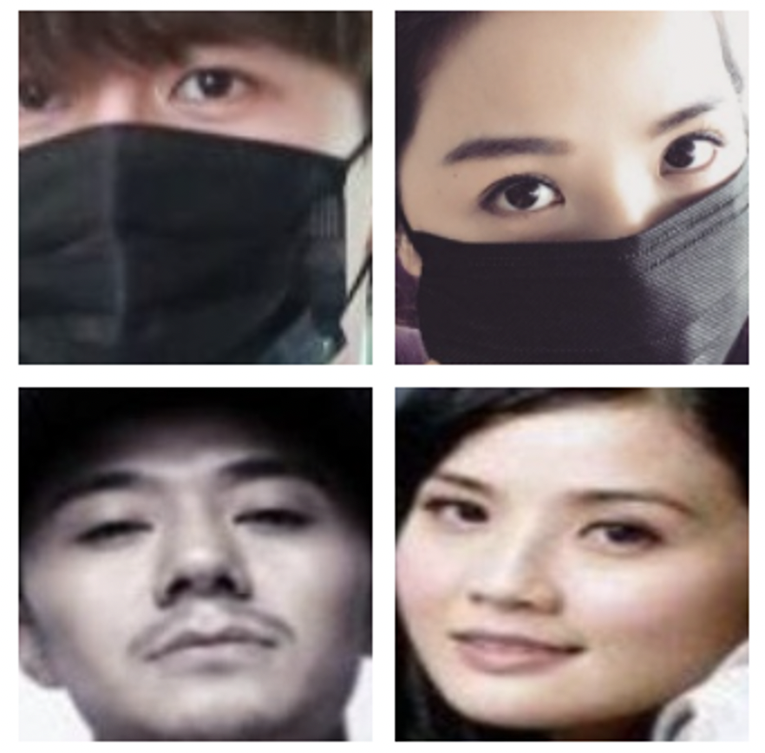
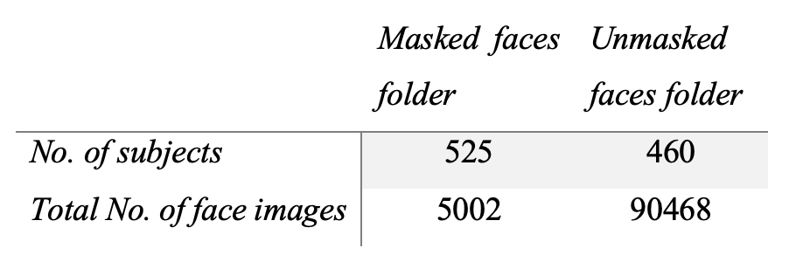
Methodology
Sample of RMFD dataset
Real-World Masked Face Dataset (RMFD):
Introduced by (Wang et al., 2020), it is world’s largest open-source dataset with masked-unmasked faces of humans
All the subjects are of Asian ethnicity
Face images are accurately cropped and centred, hence no much pre-processing required
All the face images are properly labelled and arranged in subfolders
Face images are paired up to created equal number of Genuine (masked-unmasked pair belong to the common subject) and Impostor (masked-unmasked pair belong to the different subject) face image pairs, for Train, Validation and Test dataset
Summary statistics of the RMFD dataset

Slide 12
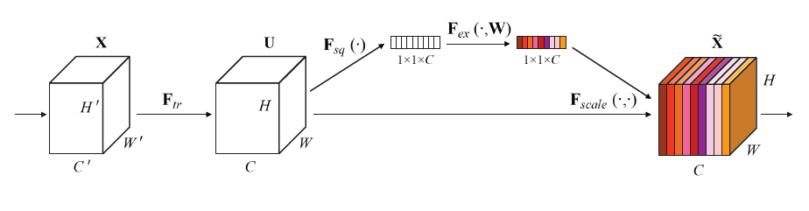
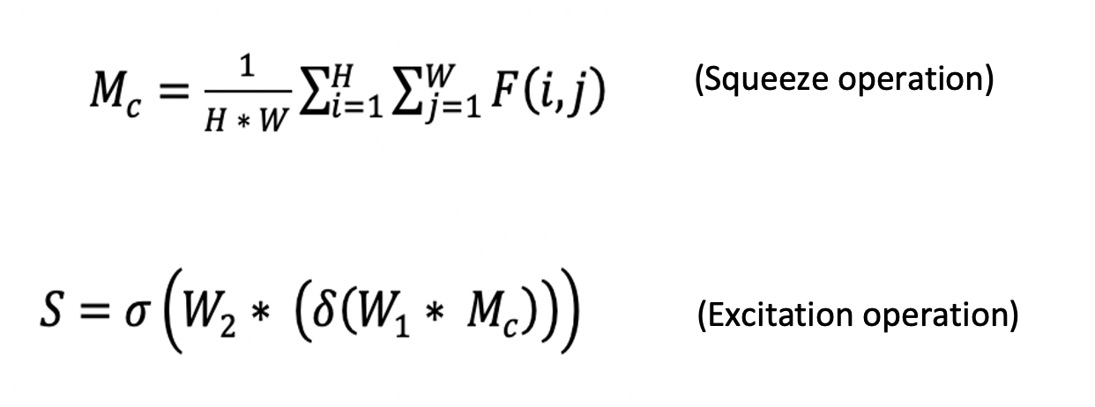
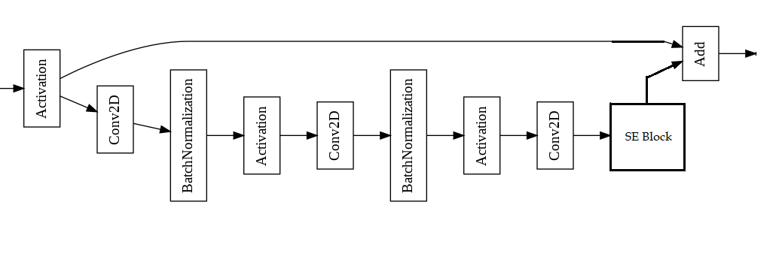
Methodology
Squeeze and Excitation (SE) layer introduced by (Hu et al., 2017) is proposed to bring attention mechanism in the core model
SE layer backed with ResNet called SE-ResNet block, proposed by (Cao et al., 2018) is brought below
SE layer operations
Model equations
SE-ResNet block architecture

Slide 13
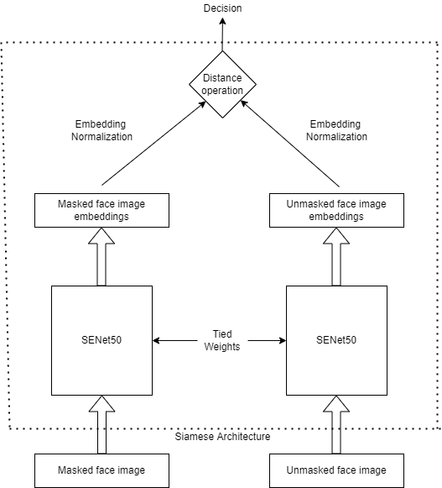
Methodology
Siamese Architecture with SENet50 as the core network
The overall network architecture contains SENet50 as core model, trained with Siamese network and custom loss function
SENet50 produces the masked-unmasked face embeddings which are used to find the distance
Loss function is defined in such a way that it increases the distance among Impostor pairs and reduce the same for Genuine pairs

Slide 14
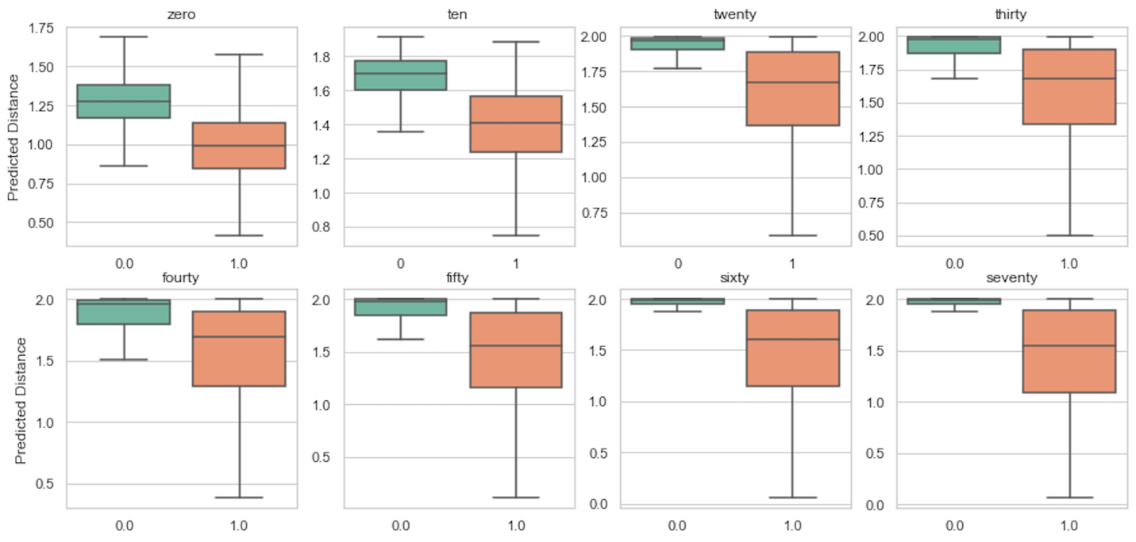
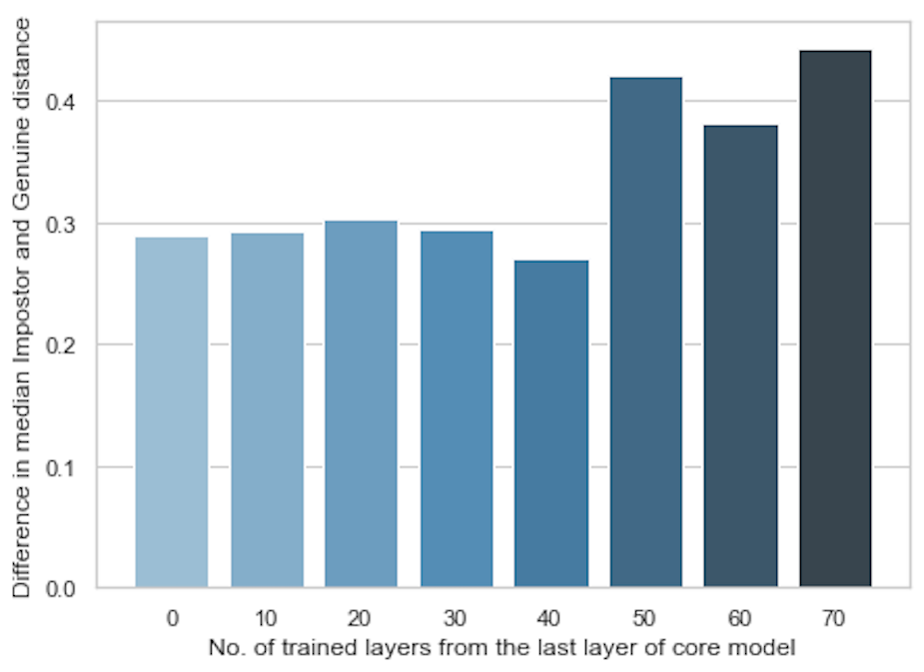
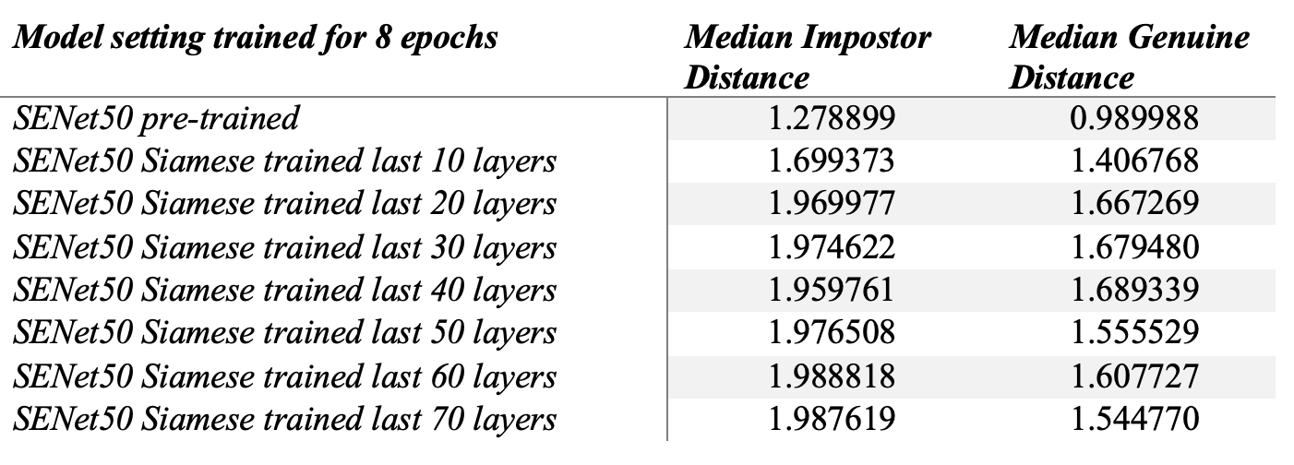
Results & Discussion
Model output for different training settings
Through model training, we can obtain higher differences in Genuine and Impostor distances
It becomes easy to choose a threshold that can differentiate Genuine from the Impostor pairs, if the distance gap is higher
Median difference between Genuine and Impostor
Median distances for different training settings

Slide 15
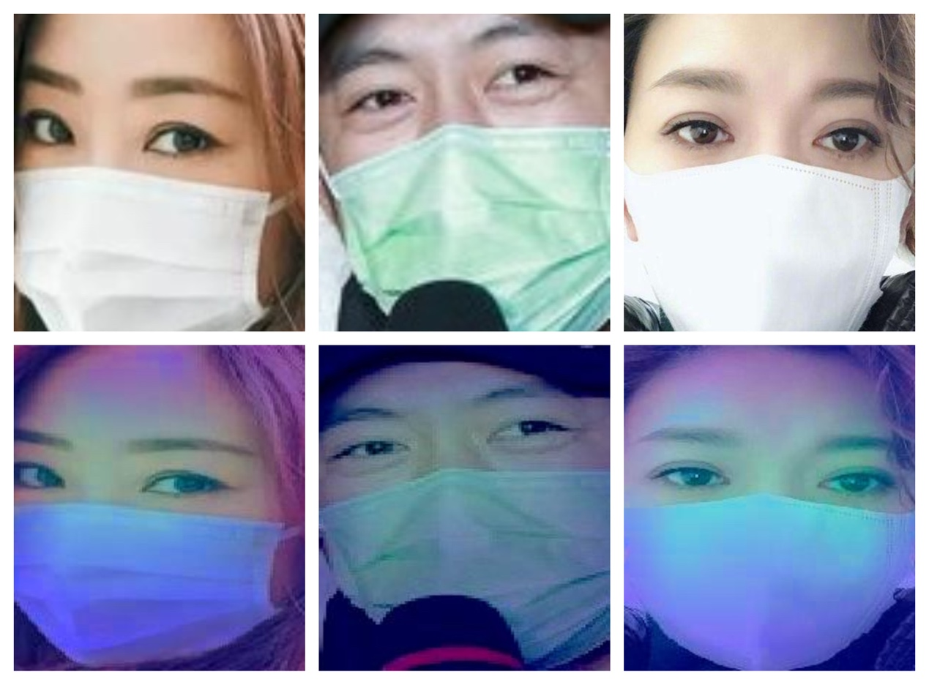
Results & Discussion
Grad-CAM output of model
Grad-CAM output illustrates that the portion of the face around the eyes, some parts of the forehead are faint yellow while the rest are dark bluish in the colour
The result indicates that our trained model pays more attention to the non-occluded region as compared to the mask-occluded region, during prediction

Slide 16

Conclusion and Future Works
The attention mechanism aid the model to focus on the important region of the face image rather than the non-important one
The Shift and Excitation layer could aid in inculcating the attention mechanism in the model and hence helps in achieving the target results
Model fine-tuning with metric learning and a custom loss function aid in instilling the generalization capability
Siamese architecture leads to promising results in this field of study due to its generalization capability
The transfer learning with a model pre-trained on a similar task helps in achieving good results with a fewer number of iterations, trainable parameters

Slide 17

Conclusion and Future Works
The different layers with attention mechanisms could be explored that may provide a relatively better edge as compared to the Shift and Excitation layer in focusing on the relevant part of the face images
Other metric learning architecture could be tried with similar experimental settings to truly realize the power of the training network

Slide 18

Limitations of the Work
Model training on different dataset
RMFD contains face images of subjects from the Asian community, with most of the faces without items like face tattoos, special clothes, pieces of jewelry, etc.
The presence of these objects might hinder or limit the model to get trained at its best
SOTA Transformer models might outperform the proposed model due to its complexity and relatively higher number of parameters

Slide 19

Thank You

